Slide 1
Quark
Sensor Positioning
Aqarios | PushQuantum
Ashish, Vishnuthirtha , Adrian Raiser, Marvin Raiser

Slide 2
The Problem

Slide 3
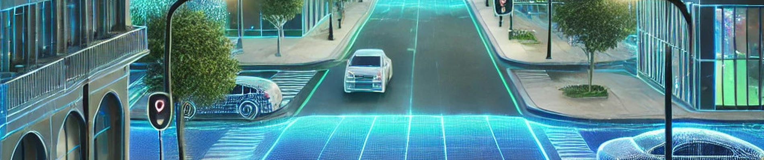
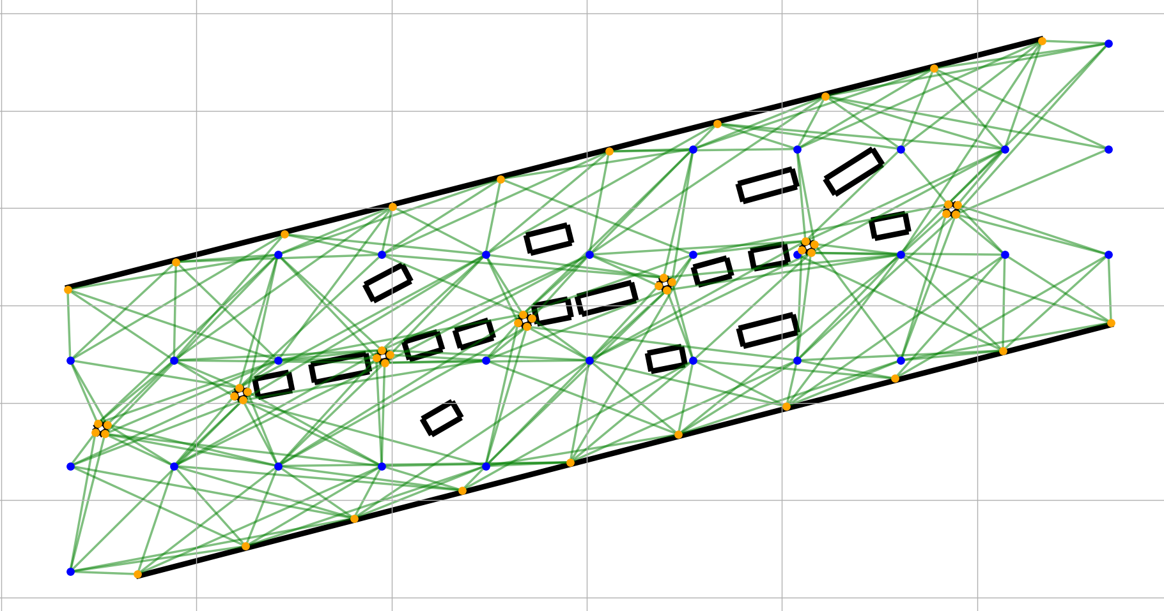
Problem Description

Slide 4
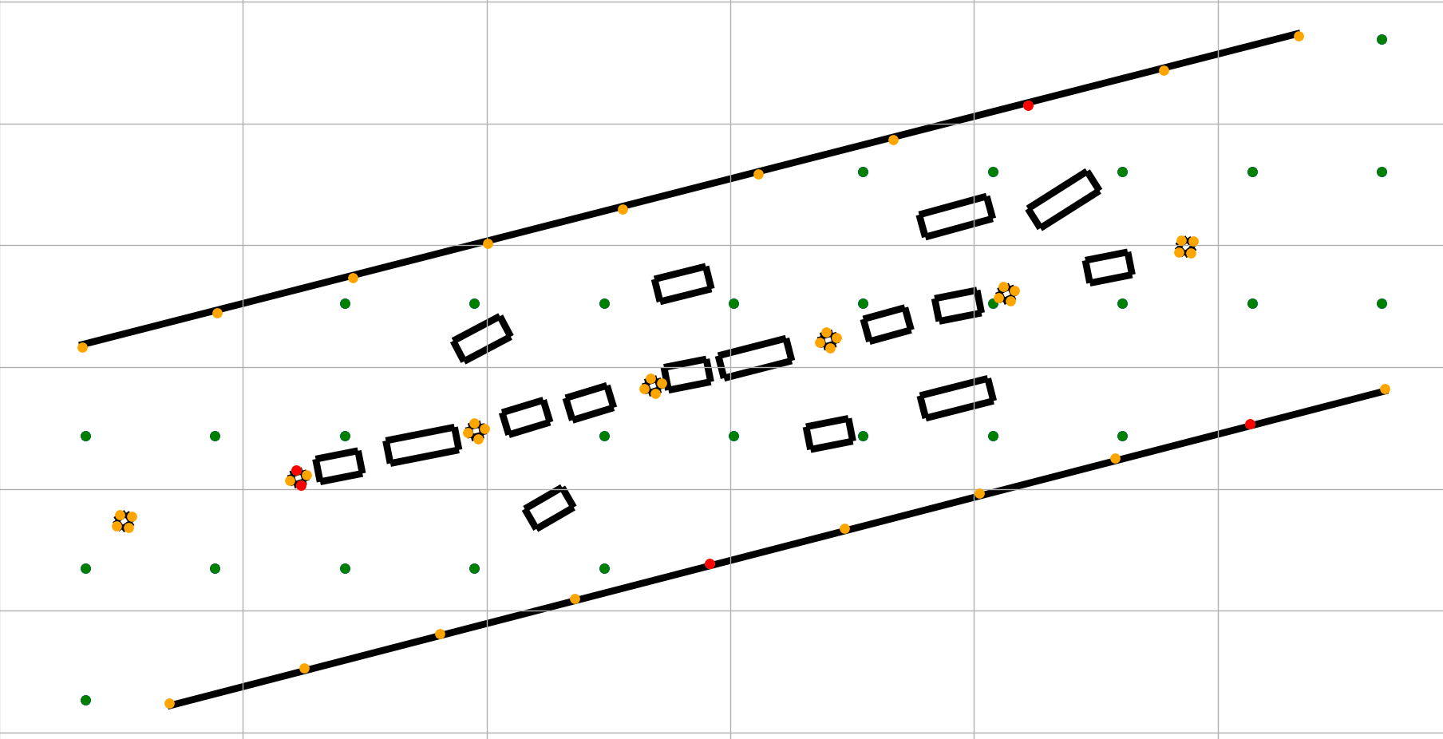


Problem Description
Given a set of Lidar Placement Points X and a set of Points of Interest (Street Points) V,
The objective is to minimize the amount of installed Lidar sensor, while every Point V has to be seen by at least one Lidar:

Slide 5
Assembling the Q matrix
Target: min( x^T * Q * x + d^T * x + c )
Problem is described as inequality => Introduction of “slack values”
Every slack value increases complexity
Collection of Cost Functions: f(x,s) = d_j*(∑x_i - s_j - 1)² for every Street Point j
Iterate over every Street Point v_j => “Submatrices” (potentially parallelizable/GPU)
Assemble Q, d and c by “adding” the Submatrices
Due to the problem being binary, d can be integrated into Q
Added to main diagonal
c represents an energy “base level”, moving the Hyperplane “up and down”
=> can be ignored
Caveats: s_j is a positive integer depending on the neighbours
state vector has to be adjusted accordingly

Slide 6
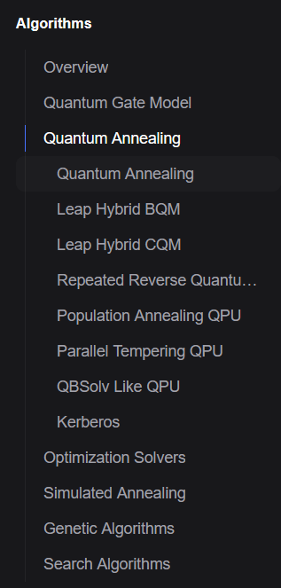
Aqarios Luna
“solving optimization problems with our advanced quantum, hybrid, and classical algorithms tailored to your unique needs.”
Transpiler for python code to run on (simulated) quantum hardware
connectable with D-Wave, IBM and others

Slide 7
DWave Quantum Computer
Runs Problems on a Quantum Annealer
Luna API as middleware between developer and DWave
Free API provides 1min computation time for free
5 Tokens used/burned
only used when Luna decides to use the qpu

Slide 8
Comparison between Algorithms

Slide 9
Benchmarking Pipeline
Parameter and Problem definition
Matrix Generation
Running on Luna & D-Wave
Exporting
Analyze & Plot
Solver
QA, QAGA+, SAGA+
(p_size)
(mut_rate)
(rec_rate)
Version (row)
num_cols
P1
P2
P3
Provide custom matrix
generate with given scenario settings
Running the APIs
Token Management
Waiting for the results
Recalculate objective value
store every run in a json file
Analyze the data by reading the json files
plotting the results

Slide 10
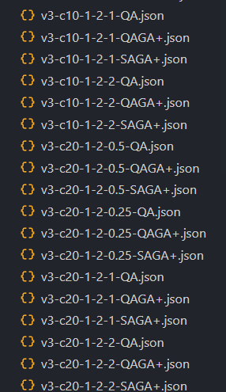
DWave Quantum Computer
150 Benchmark Runs
5 D-Wave Tokens burned

Slide 11
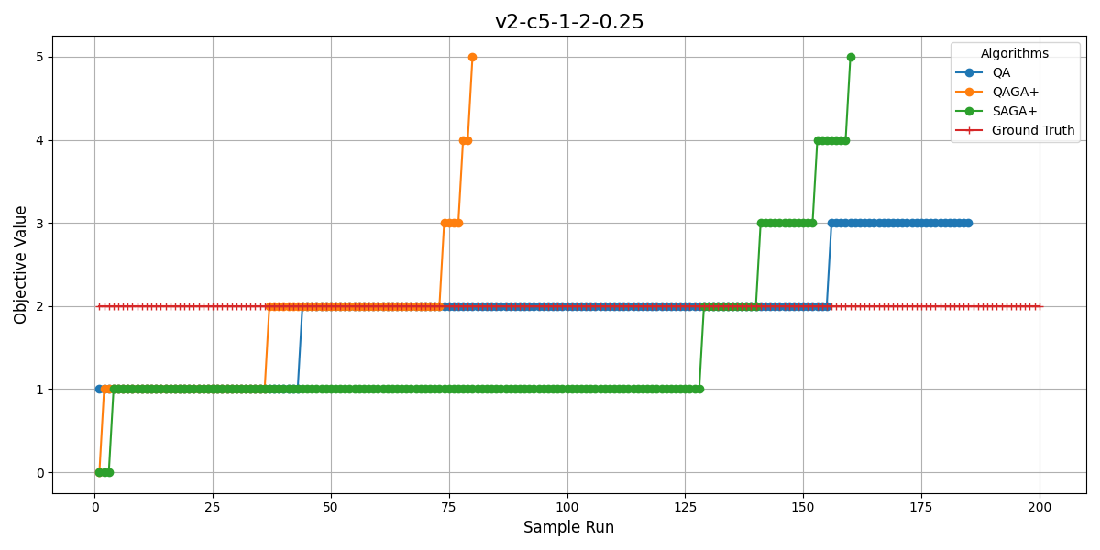
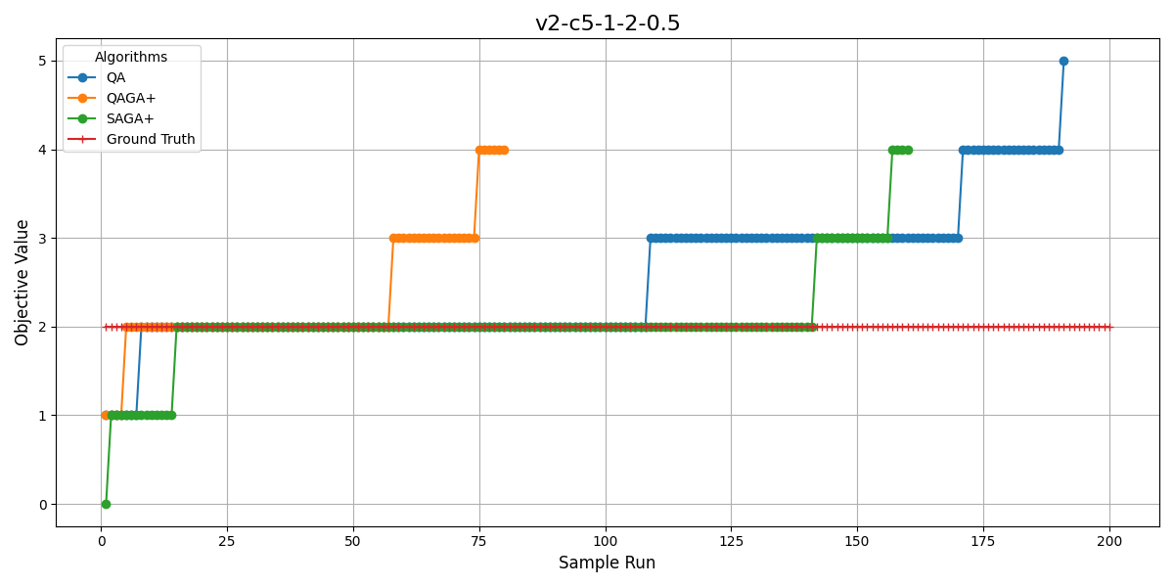
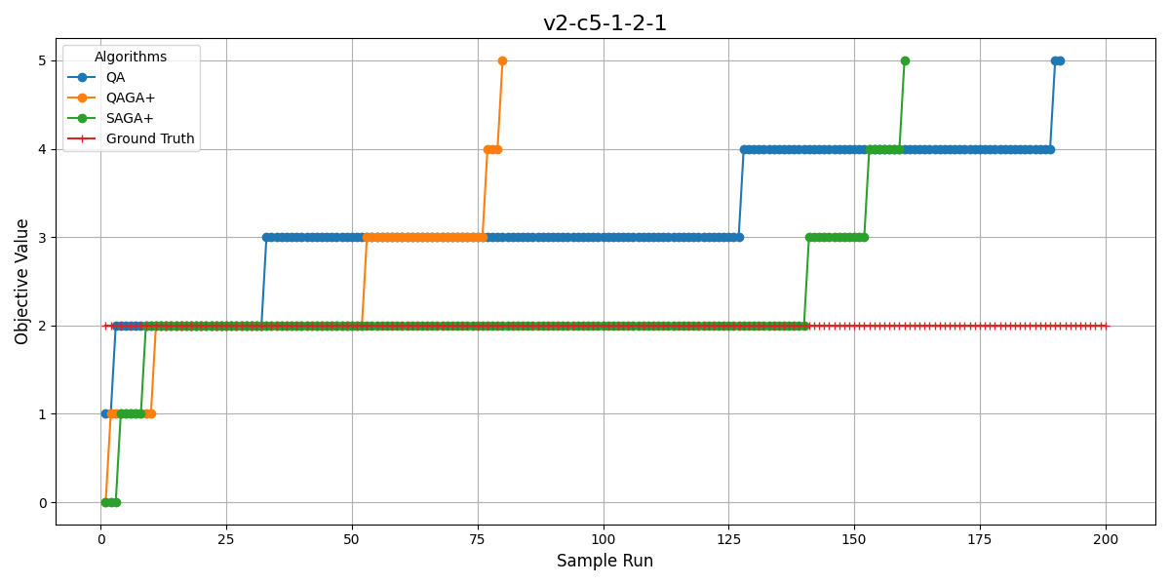
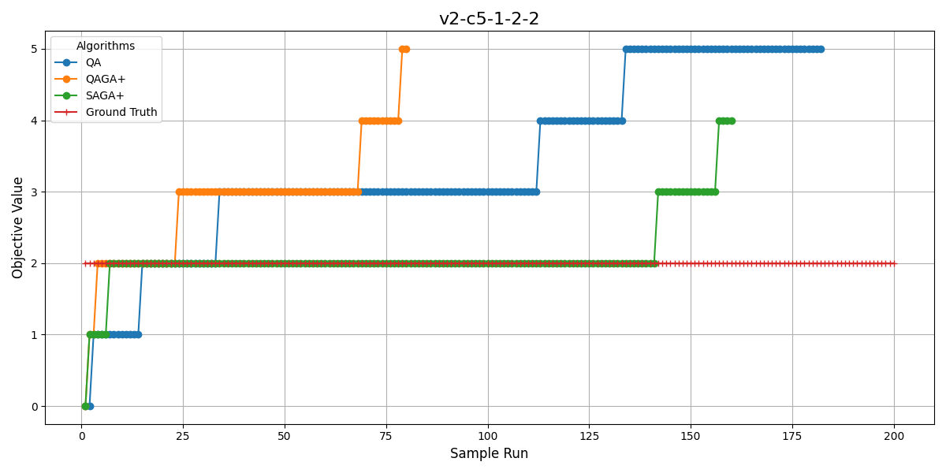

Slide 12
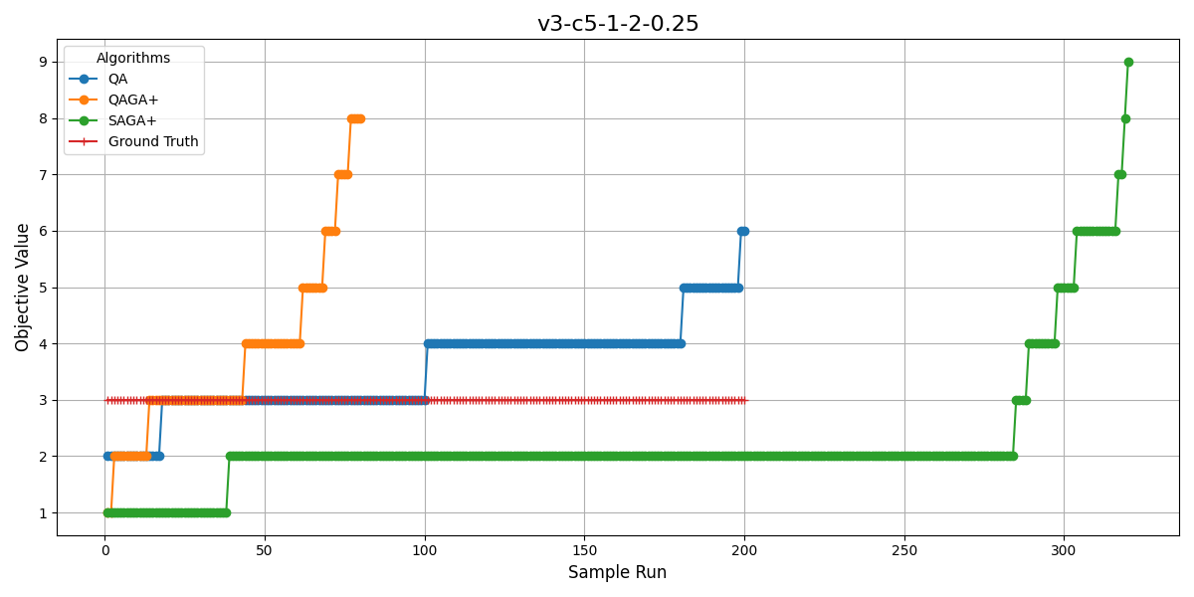
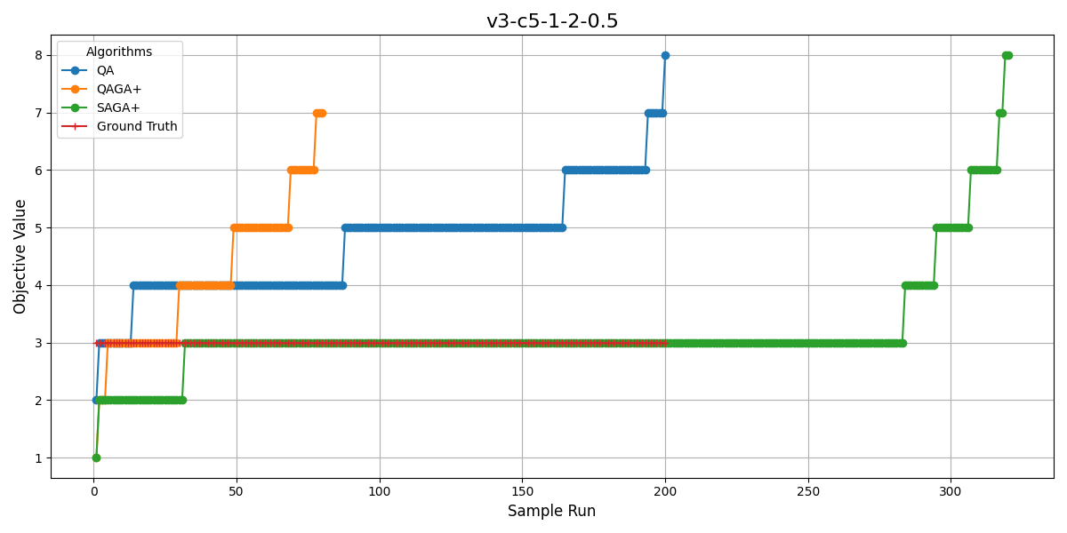
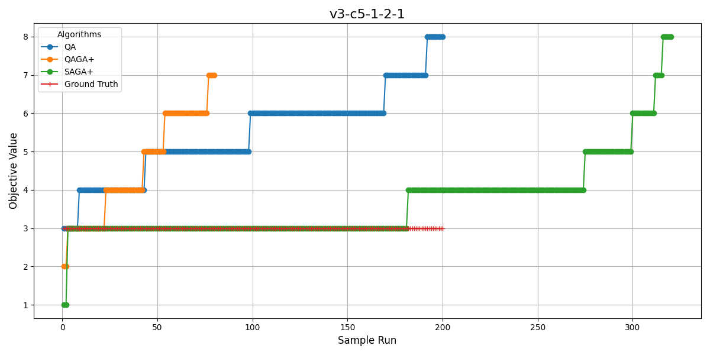
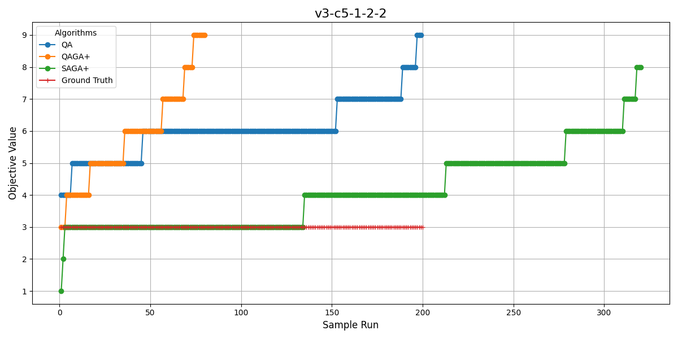

Slide 13
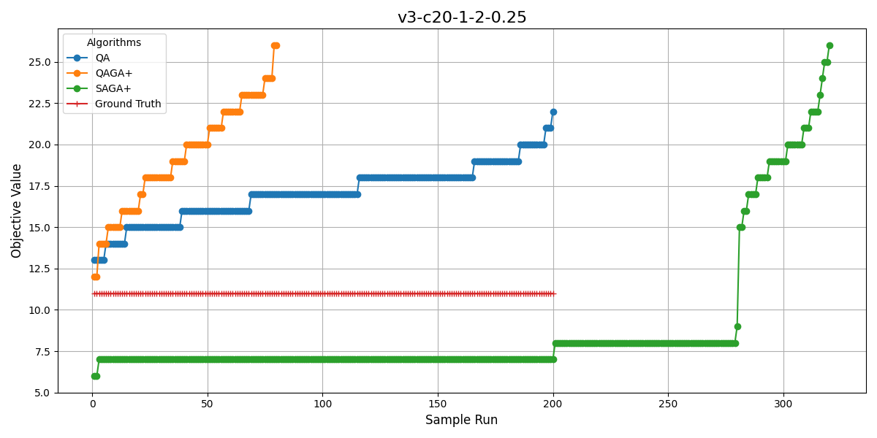
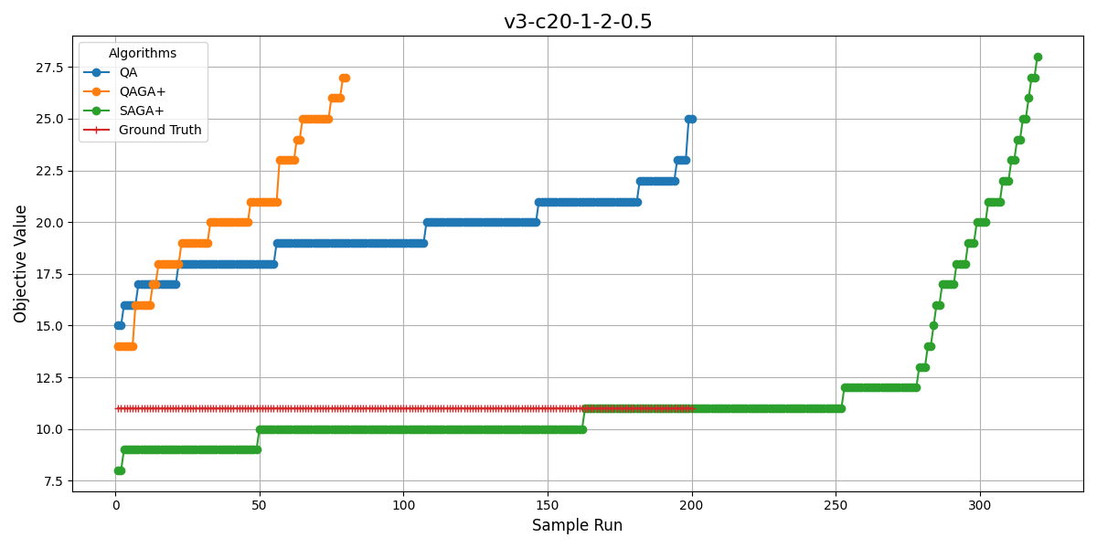
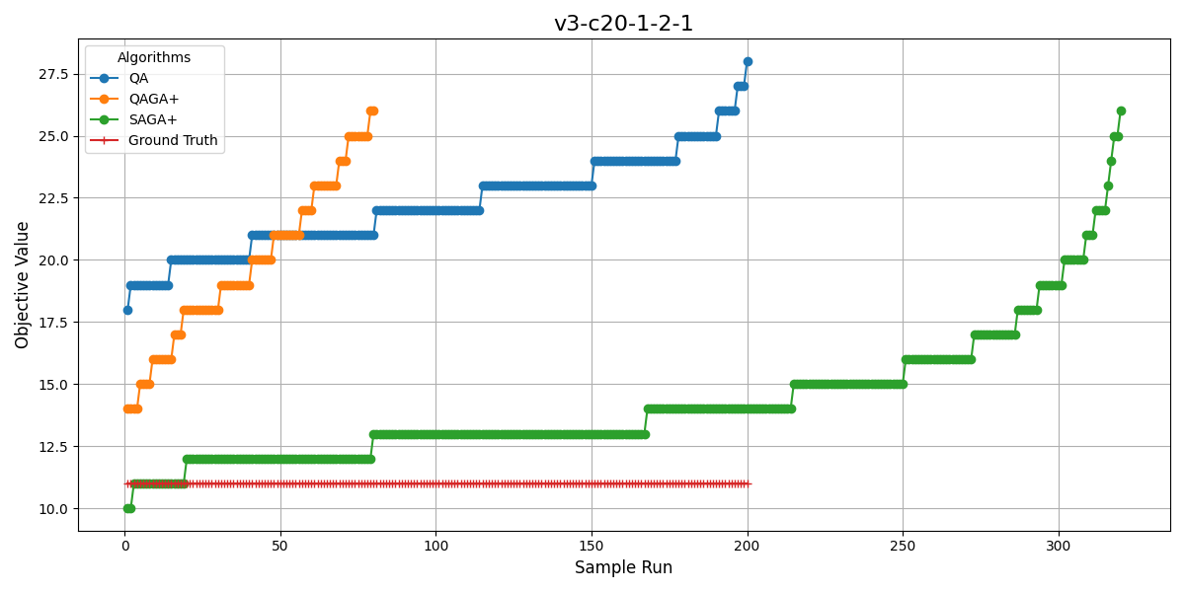
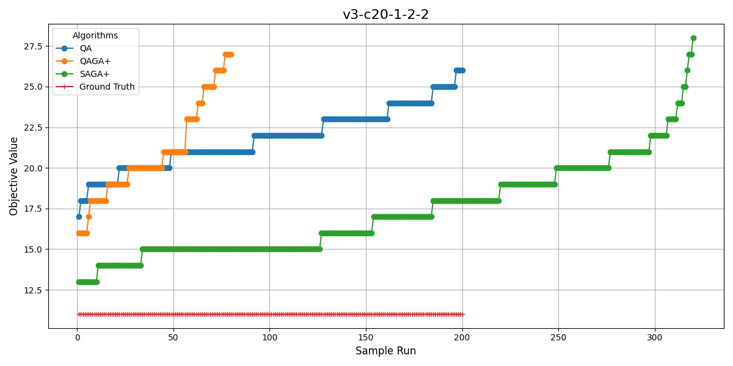

Slide 14
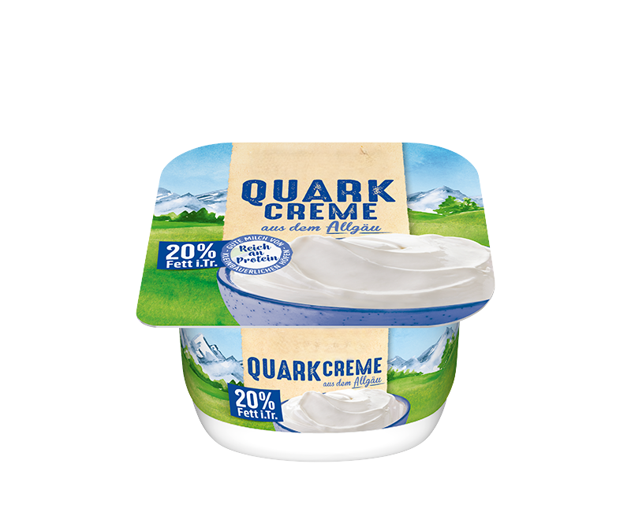

Thanks for taking a look at our Quark
Link to our Repo: https://github.com/Raisierer/PushQuantumSP

